Slide 1


ETL for Bank BTPN Syariah Credit Card Customer
Gilang Wiradhyaksa

Slide 2
Extract Transform Load
Data History Customer
Visualization for Analytics
Data source is from Bank BPTN Syariah Credit Card customer history.
The result is data that is ready to be used for analysis aimed at reducing customer churn.

Slide 3
ETL Process Infographics
Load
Load transformation result to DB and CSV
Transform
Transform the data using SSIS
Extract
Visualization
Data extraction using SQL Server Integration Services (SSIS)
Create a visualization from clean data using Tableau
Automation
Run the SSIS package with Apache Airflow

Slide 4
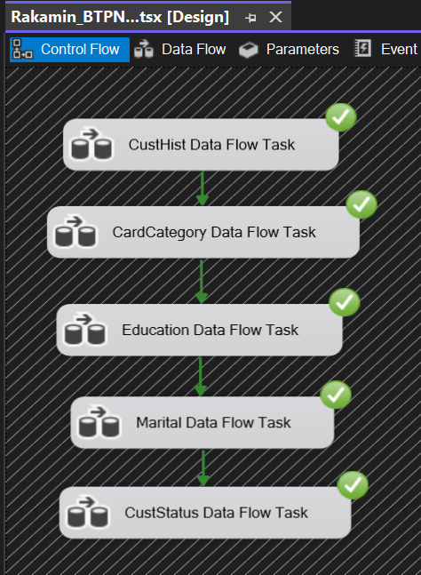
ETL Process using SSIS
SSIS Package
Start from creating a new SSIS Package.
Connection Manager
Create a new Flat File connection and choose Bank BTPN Syariah CSV file as sources.
Data Flow Task
Create five dataflow tasks with the provided data which is Customer History, Card Category, Education, Marital and Customer Status

Slide 5
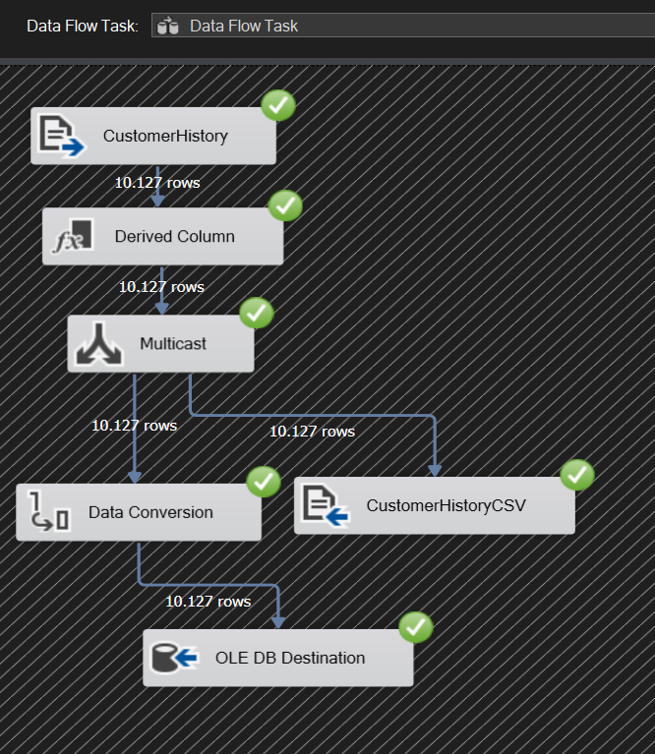
Data Flow Task Process - SSIS
Extract Data
Inside the data flow task, create Flat File Sources to Extract Data. Choose data source from connection manager which has been created previously.
Transform Data
Begin the process of transforming data such as Derived Column, Data Type Conversion etc.
Multicast
Split the process to two or more output. So it can be treated individually. In this case data conversion is only done for data that will be stored in the database.
Load Data
Load the transformation result to CSV and Database simultaneously.

Slide 6
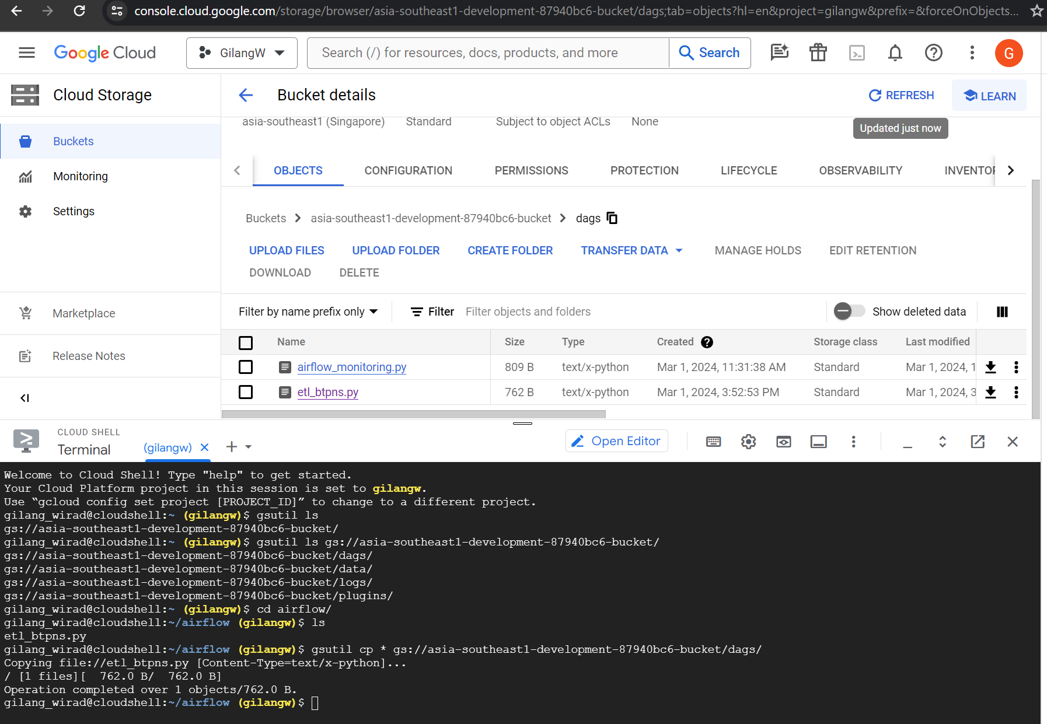
Automation Process – Apache Airflow
Python file contains DAG code
Deploying DAGs
First create Airflow DAG in GCP for scheduling and running bash command. After it done, deploying .py file to DAG folder so it can appear in Airflow Task
Command gsutil cp to copy python files to dags folder

Slide 7
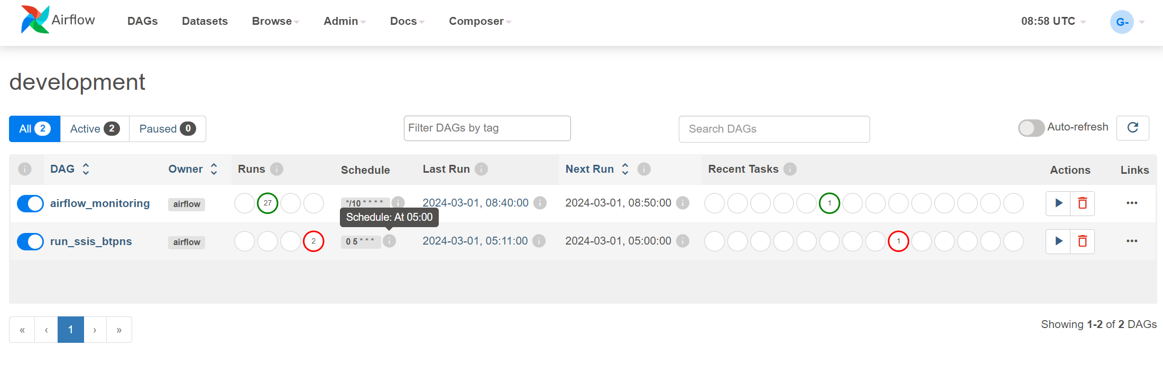
Automation Process – Apache Airflow
Deploying DAGs
DAGs is appear in Airflow Task with the name “run_ssis_btpns” and scheduled to run everyday at 5 am

Slide 8
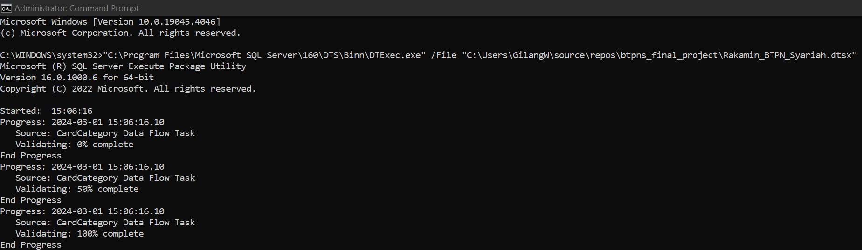
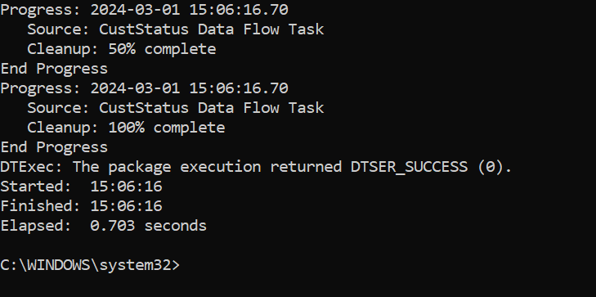
Automation Process – Apache Airflow
Bash Command
Bash command to run SSIS Package (dtsx file) that executed using Apache Airflow.
Result
Result of SSIS Package that have been executed. The ETL process is done and produce clean data to be further used for data visualization in Tableau

Slide 9
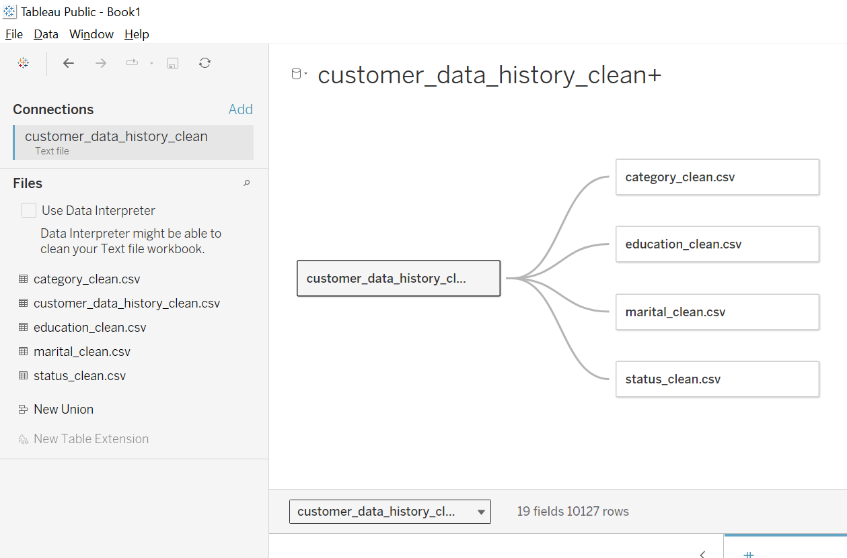
Create Relation for CSV file - Tableau
Add Data
Add Text File then choose CSV file that has been cleaned before. Repeat this step until all CSV file is loaded to Tableau.
Relation
Set a relation between CSV file. Choose the foreign key between data to create a relation.

Slide 10
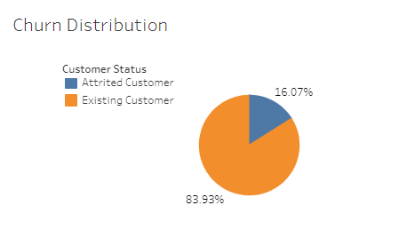
Churn Distribution
Churn Rate
Churn customer for BTPN Syariah Credit Card customer is at 16.07%.
Considered bad because according to forbes.com the normal churn rate is 5-7%.

Slide 11
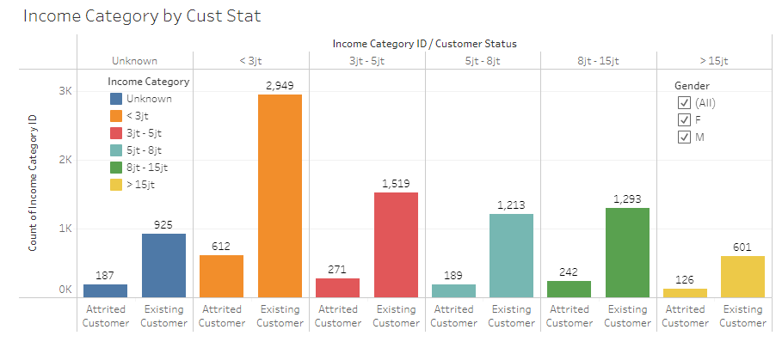
Income Category by Customer Churn
Income Category
Most of the credit card customer is in low-income category.
Most churn customer is came from customer with under 5m per month.

Slide 12
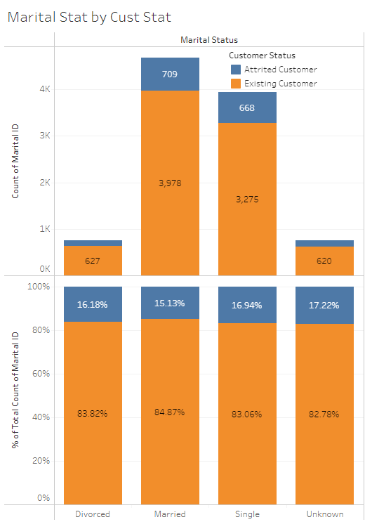
Marital Status by Customer Churn
Marital Status
Most of the Credit Card customer is Single and Married.
Percentage of customer churn in each status is about the same at 15-17%.

Slide 13
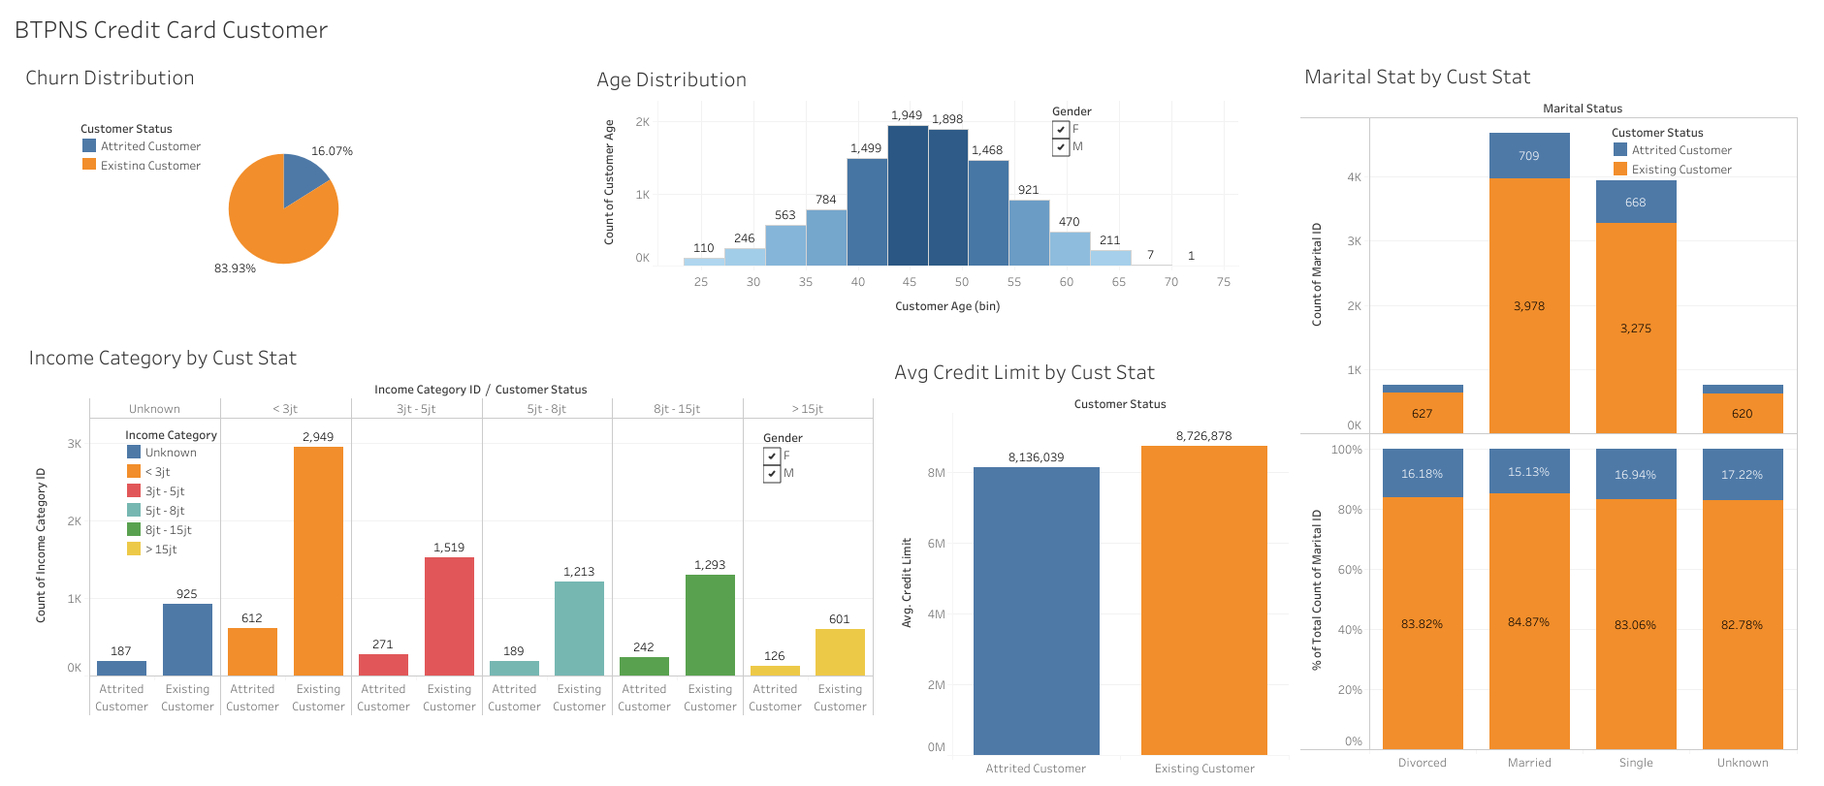
Dashboard - Tableau

Slide 14
Conclusion
Based on the visualization we found that most of Bank BTPN Syariah Credit Card customer is came from people with income less than 5m per month.
Also their most customer age is between 40 to 55 years old.
The percentage of customer churn based on marital status is about the same. Means there is no correlation between churn and marital status.

Slide 15
Suggestion
For customer with high-income, giving a reward for using their credit card very often, so this customer will feel appreciated and respected. For high-income customer, appreciating them is more important rather than give them a discount or promotion.
Whilst for low-income customer can give them a promotion/discount for a relatively low-cost item if they use credit card to attract them for using their credit card more.
Do not make a promotion based on the marital status since there is no correlation between marital status and customer churn.
Invest in providing exceptional customer service experiences. Ensure that customer support is easily accessible, responsive, and empathetic. Train representatives to address customer concerns effectively and resolve issues promptly.

Slide 16
Thank You
Presented by
Gilang Wiradhyaksa
LinkedIn : in/gilangwiradhyaksa/
Email : gilang.wirad@gmail.com
GitHub : github.com/gilangwd

